Slide 1

Learning Objective
I will plot the graph of quadratic equations.
Enter quietly, please be ready with the following on your desk:
Whiteboard
Whiteboard marker
Exercise Book
Pencil, pen, ruler and red pen
Diary
Calculator
Device – charged or borrowed from Library before maths

Slide 2

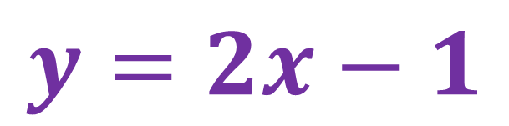

Daily Review
Plotting Linear Equations
Graph the following relationship.
$$y=2x−1$$
Step 1: Draw a table. Pick a range of values for x.
$$x$$
$$y$$

Slide 3


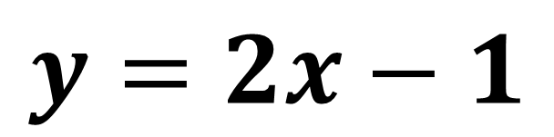

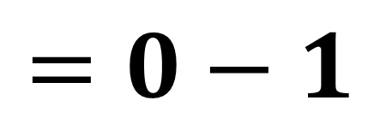
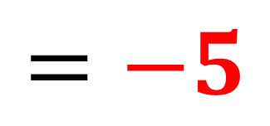

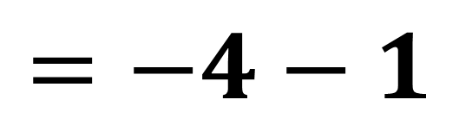
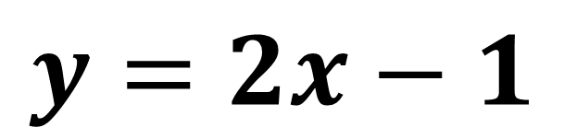

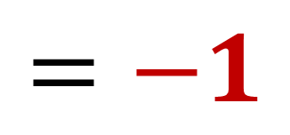
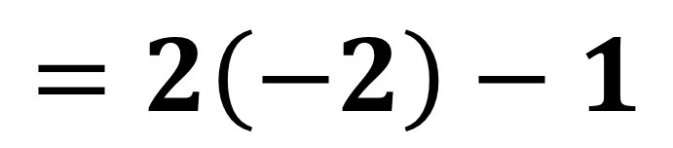




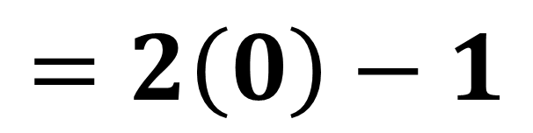




Daily Review
$$y=2x−1$$
Step 2: Complete the table.
$$x$$
$$−2$$
$$−1$$
$$0$$
$$1$$
$$2$$
$$y$$
$$−5$$
$$−3$$
$$−1$$
$$1$$
$$3$$
$$y=2x−1$$
$$y=2x−1$$
$$=2\left(−2\right)−1$$
$$=2\left(0\right)−1$$
$$=−4−1$$
$$=−5$$
$$=0−1$$
$$=−1$$

Slide 4
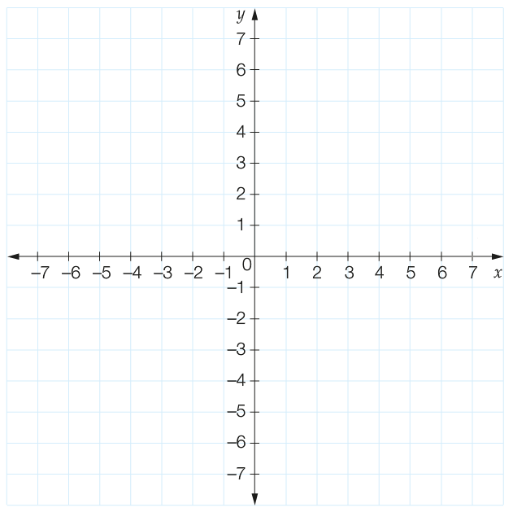
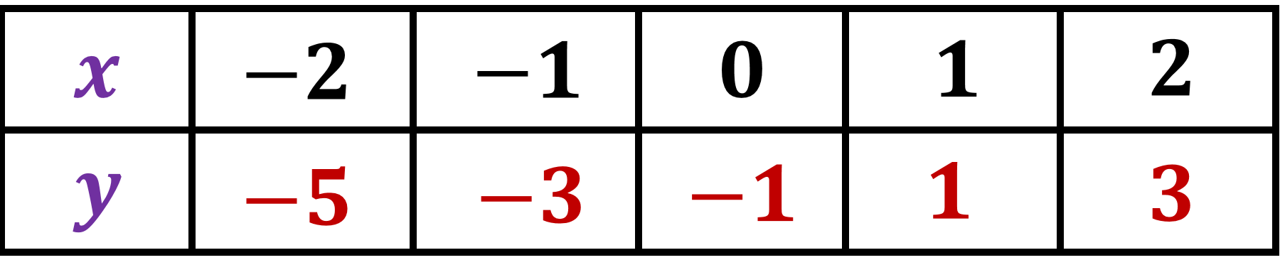

Daily Review
Step 3: Draw up your axes.
Step 4: Plot your coordinates.
$$y=2x−1$$
Step 5: Draw a line through
your coordinates.
Step 6: Label the line.

Slide 5
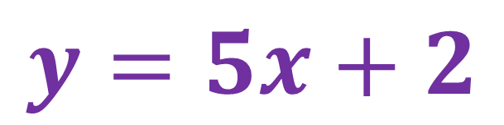
Daily Review
Plotting Linear Equations
Graph the following relationship.
$$y=5x+2$$
Step 1: Draw a table. Pick a range of values for x.
$$x$$
$$y$$

Slide 6


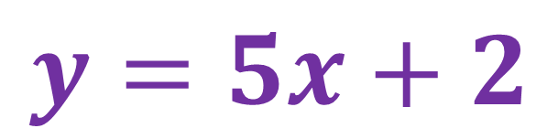

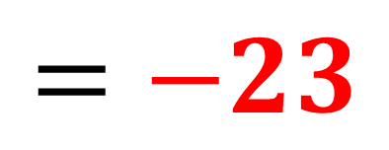

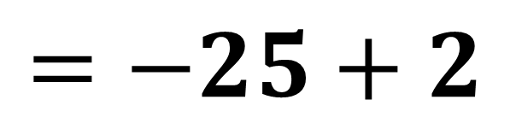
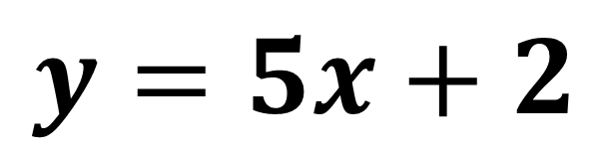

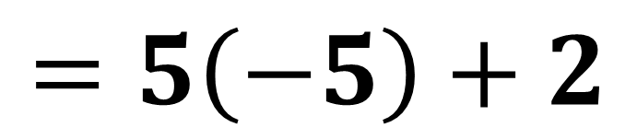

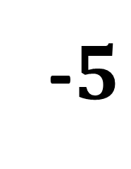





Daily Review
$$y=5x+2$$
Step 2: Complete the table.
$$x$$
-$5$
-$2$
$$0$$
$$2$$
$$5$$
$$y$$
$$−23$$
$$−8$$
$$2$$
$$12$$
$$27$$
$$y=5x+2$$
$$=5\left(−5\right)+2$$
$$=−25+2$$
$$=−23$$

Slide 7
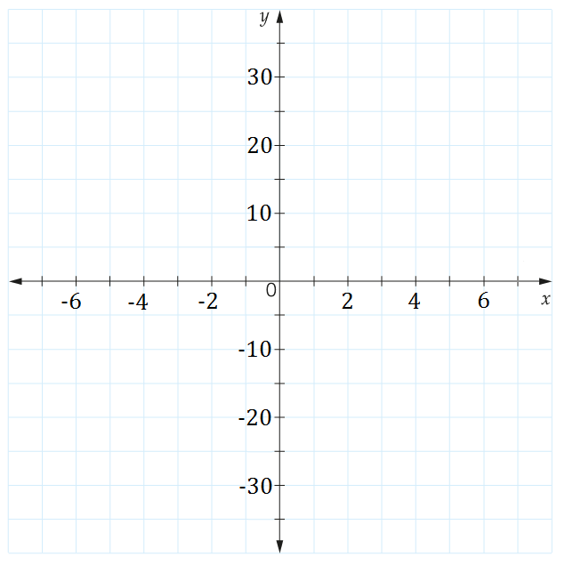
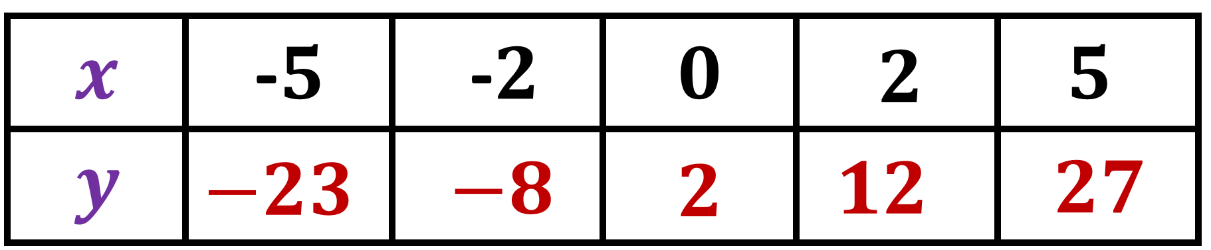

Daily Review
Step 3: Draw up your axes.
Step 4: Plot your coordinates.
$$y=5x+2$$
Step 5: Draw a line through
your coordinates.
Step 6: Label the line.

Slide 8
Learning Objective
CFU 1
What will we learn?
I will plot the graph of quadratic equations.
CFU 2
What will we learn?
CFU 3
How will we know if we’ve been successful?
Success Criteria
CFU 4
How will we know if we’ve been successful?
I will be able to:
Recognise if an equation is linear or quadratic
Complete a table of values for a quadratic equation
Plot co-ordinates on a Cartesian plane

Slide 9
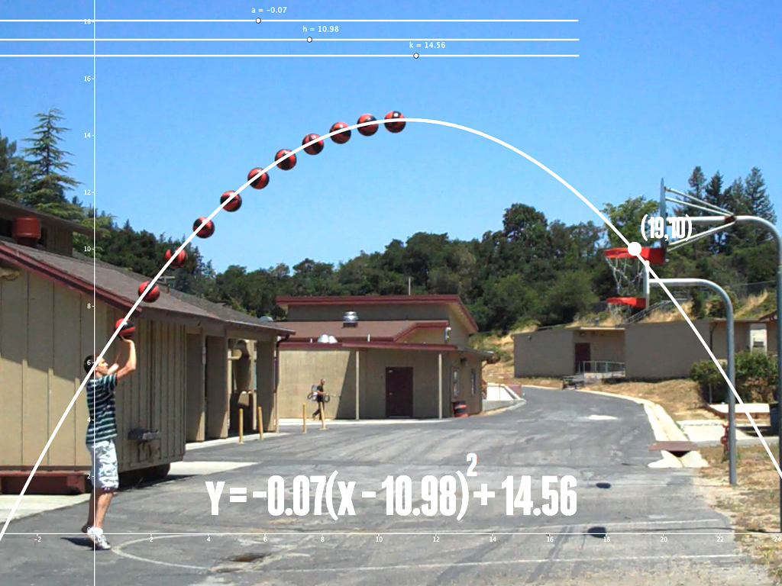
Activate Prior Knowledge
Not all relationships are linear (form straight lines)!
The flight path of a basketball
The area of a block of land
Calculating profits

Slide 10
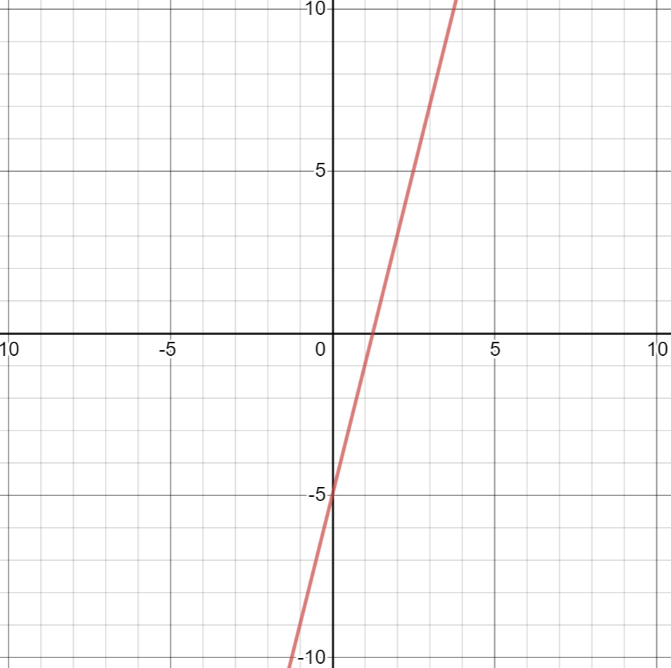
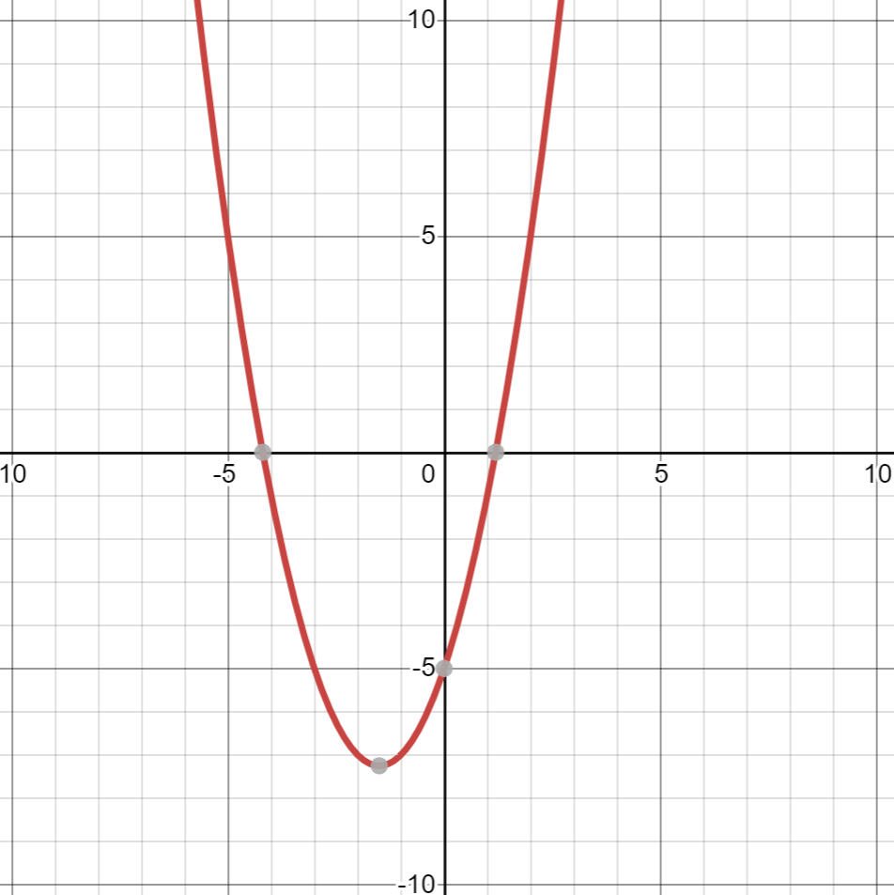
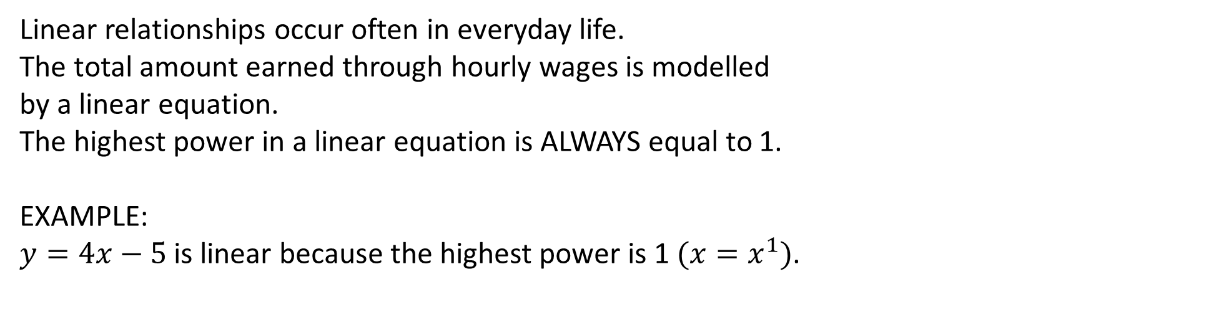
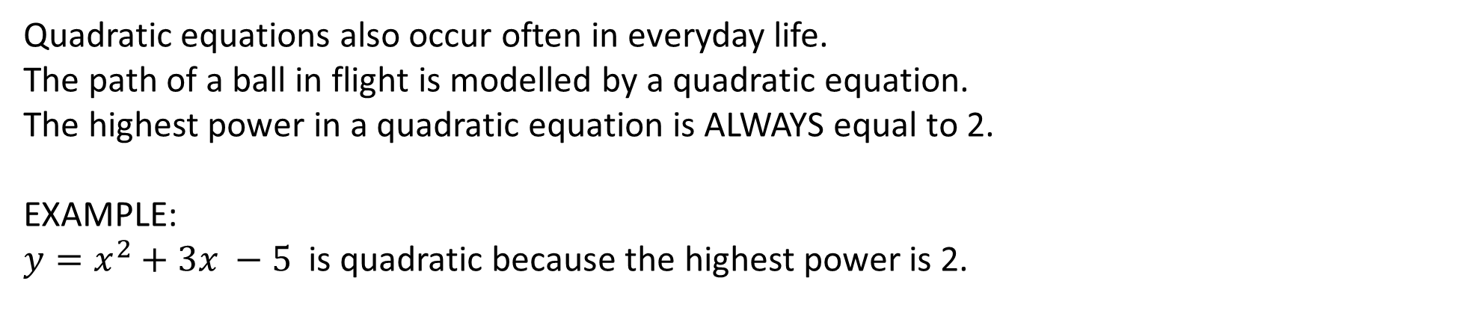
Concept Development
VOCABULARY
Quadratic – an equation where the highest power is 2 Parabola – the graph of a quadratic equation (looks like a u or a n)
Linear relationships occur often in everyday life.
The total amount earned through hourly wages is modelled
by a linear equation.
The highest power in a linear equation is ALWAYS equal to 1.
EXAMPLE:
$y=4x−5$is linear because the highest power is 1 $(x=x^{1})$.
If we graph a linear equation, we get a straight line.
Quadratic equations also occur often in everyday life.
The path of a ball in flight is modelled by a quadratic equation.
The highest power in a quadratic equation is ALWAYS equal to 2.
EXAMPLE:
$y=x^{2}+3x −5$is quadratic because the highest power is 2.
If we graph a quadratic equation, we get a parabola.

Slide 11

Guided Practice
VOCABULARY
Quadratic – an equation where the highest power is 2 Parabola – the graph of a quadratic equation (looks like a u or a n)
Which of the following is a quadratic relationship?
$${y=x}^{2}+1$$
$${y=2x}^{3}+x^{2}+3$$
$${y=−3x}^{2}+2x −8$$
$$y=4x+5$$
$${y=x}^{2}$$
$$y=3x−x^{2}$$
YES, it is quadratic, because the highest power is 2.
NO, it is NOT quadratic, because the highest power is 3.
YES, it is quadratic, because the highest power is 2.
NO, it is NOT quadratic, because the highest power is 1.
YES, it is quadratic, because the highest power is 2.
YES, it is quadratic, because the highest power is 2.

Slide 12




Guided Practice
Sketch the graph of the following equation $y = x2+2x+3.$
We want to graph the equation $y = x2+2x+3$using integer
values of x from -3 to 2. Substitute each number into the equation to find the
points we need. (Use a scientific calculator and brackets to help you do this.)
$$y = x2+2x+3$$
$$y =\left(−3\right)2+2\left(−3\right)+3$$
$=+9−6+3$
$=6$
$$y = x2+2x+3$$
$$y =\left(−1\right)2+2\left(−1\right)+3$$
$=+1−2+3$
$=2$
$$y = x2+2x+3$$
$$y =\left(2\right)2+2\left(2\right)+3$$
$=4+4+3$
$=11$
x | -3 | -2 | -1 | 0 | 1 | 2
y | 6 | 3 | 2 | 3 | 6 | 11

Slide 13




Guided Practice
Sketch the graph of the following equation $y =5x2+4.$
We want to graph the equation $y =5x2+4$using integer
values of x from -3 to 2. Substitute each number into the equation to find the
points we need. (Use a scientific calculator and brackets to help you do this.)
$$y =5x2+4$$
$$y =5\left(−3\right)2+4$$
$=5\left(9\right)+4$
$=49$
$$y =5x2+4$$
$$y =5\left(−1\right)2+4$$
$=5\left(1\right)+4$
$=9$
$$y =5x2+4$$
$$y =5\left(2\right)2+4$$
$=5(4)+4$
$=24$
x | -3 | -2 | -1 | 0 | 1 | 2
y | 49 | 24 | 9 | 4 | 9 | 24

Slide 14




Guided Practice
Sketch the graph of the following equation $y =−2x2+1.$
We want to graph the equation $y =5x2+4$using integer
values of x from -3 to 2. Substitute each number into the equation to find the
points we need. (Use a scientific calculator and brackets to help you do this.)
$$y =−2x2+1$$
$$y =−2\left(−3\right)2+1$$
$=−2\left(9\right)+1$
$=−17$
$$y =−2x2+1$$
$$y =−2\left(−1\right)2+1$$
$=−2\left(1\right)+1$
$=−1$
$$y =−2x2+1$$
$$y =−2\left(2\right)2+1$$
$=−2(4)+1$
$=−7$
x | -3 | -2 | -1 | 0 | 1 | 2
y | -17 | -7 | -1 | 1 | -1 | -7

